Slide 1

Pima Community College

Slide 2
Fall 2018
Purpose:
Familiarize with microcontrollers and programing to collect basic atmospheric data

Slide 3
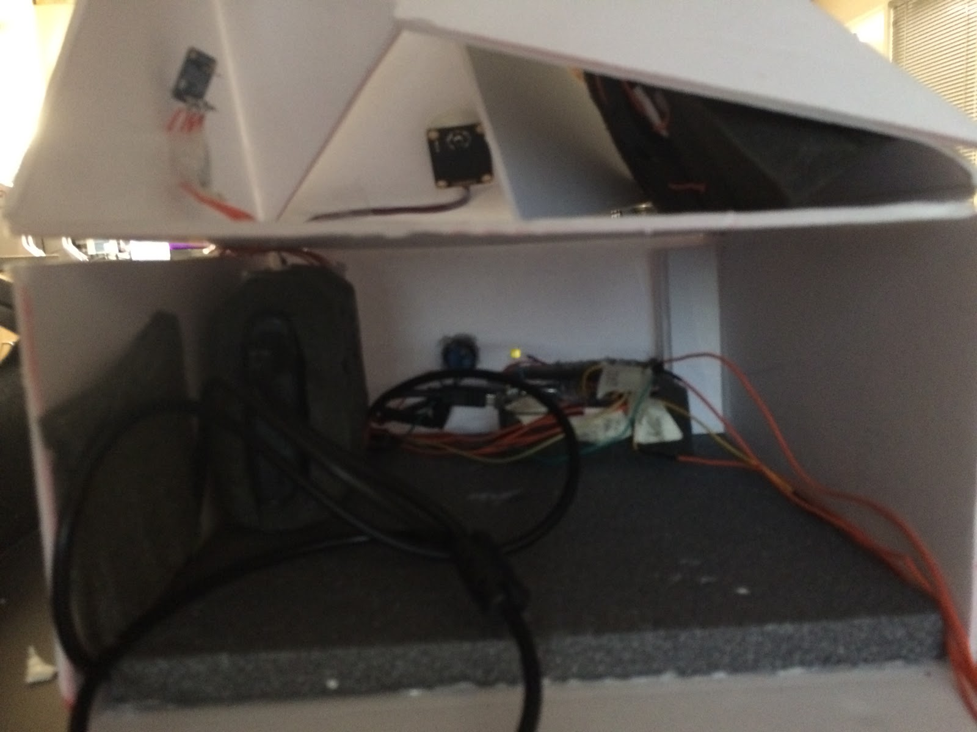
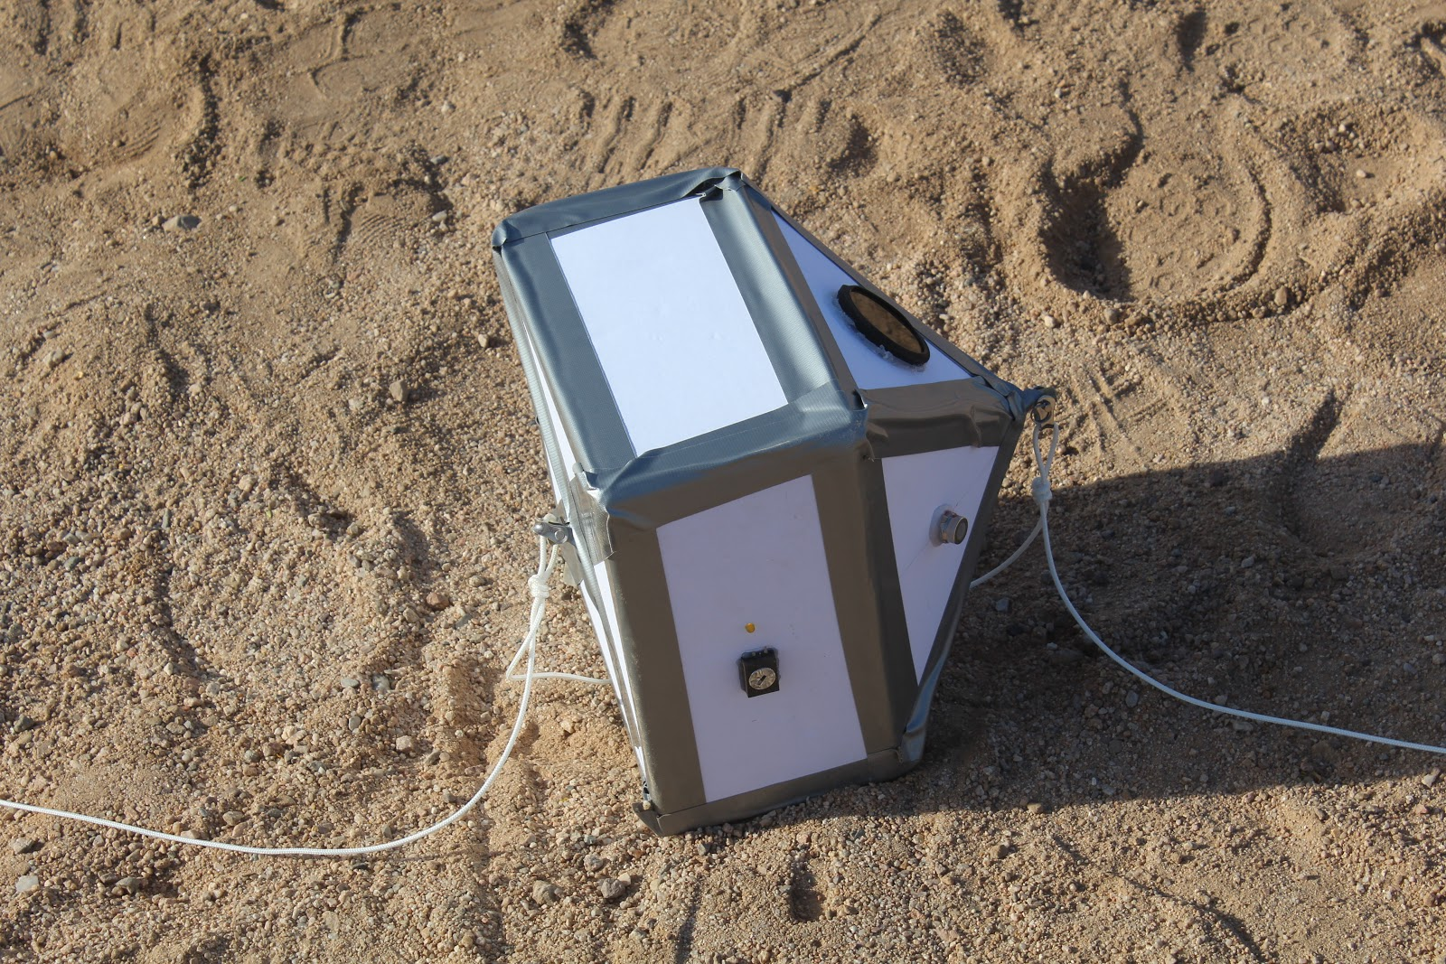
Fall Ascend 2018: Design

Slide 4
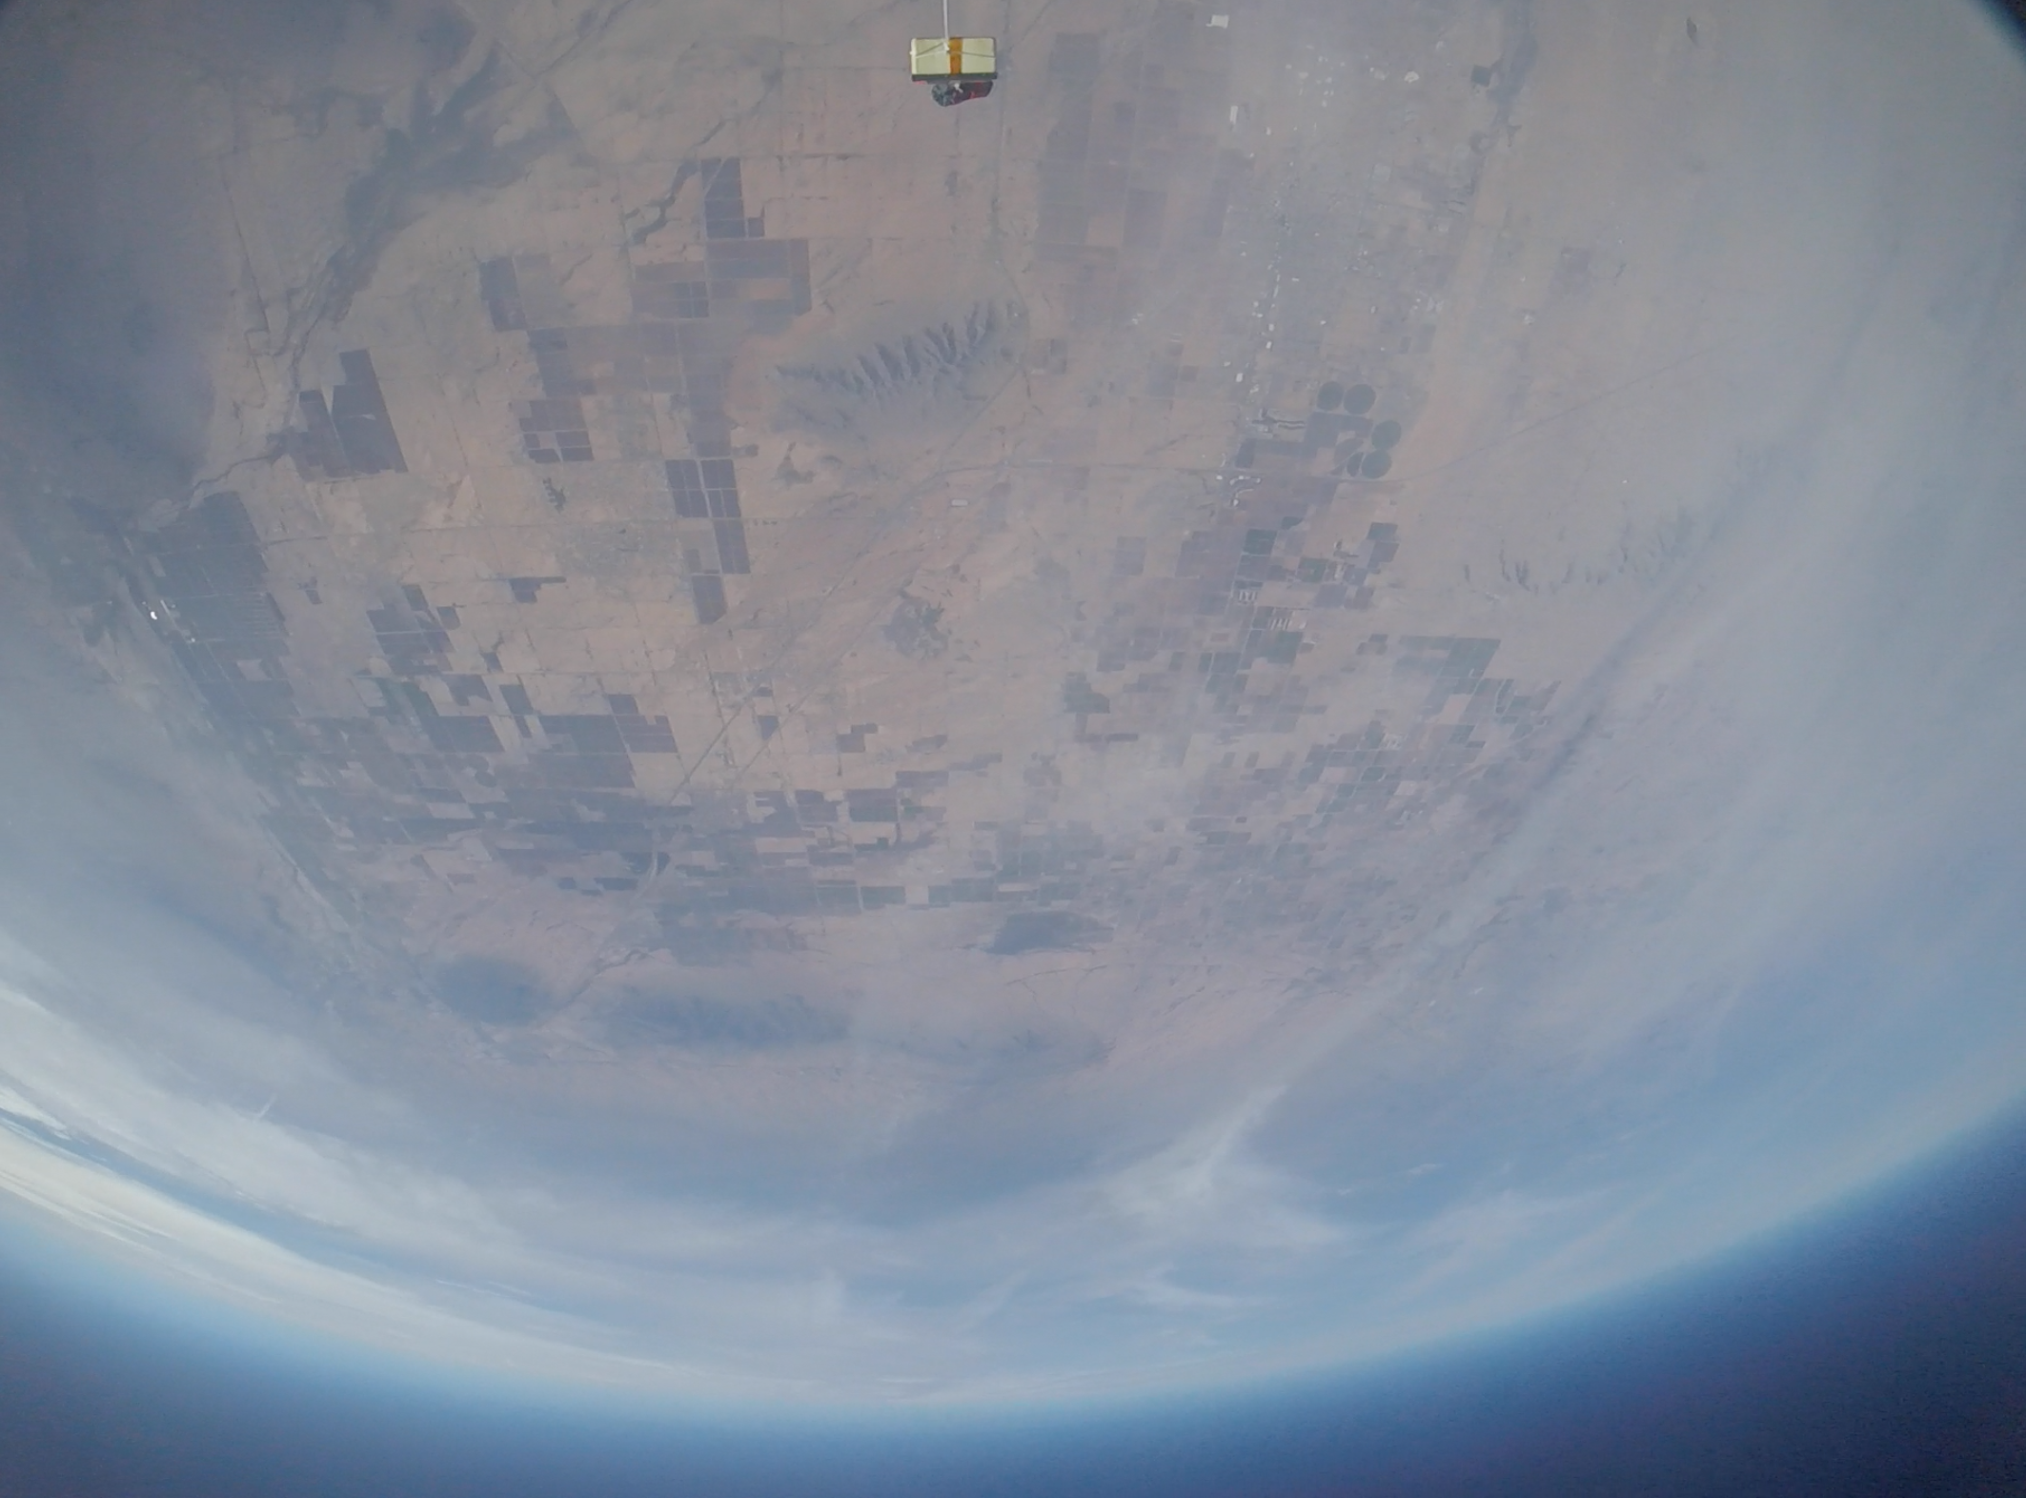
Visual data collected!

Slide 5
Fall 2018: Assessment
What Worked | What Didn’t Work
GoPro Footage | Arduino fried
Coding | No atmospheric data collected

Slide 6
Spring 2019
Purpose:
Identify whether or not the conditions of life are met in the different layers of our atmosphere, particularly in the stratosphere.
We will be measuring O2 concentration, CO2 concentration, the increase of radiation (beta and gamma rays), pressure, temperature, and humidity.

Slide 7
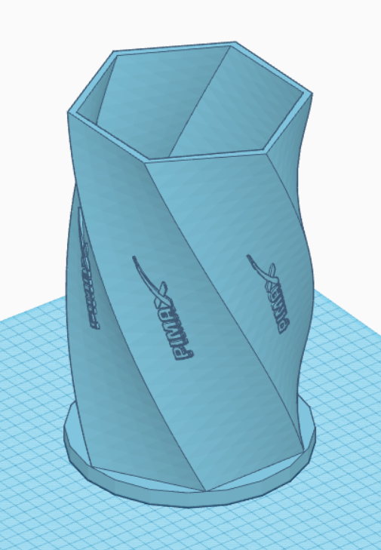

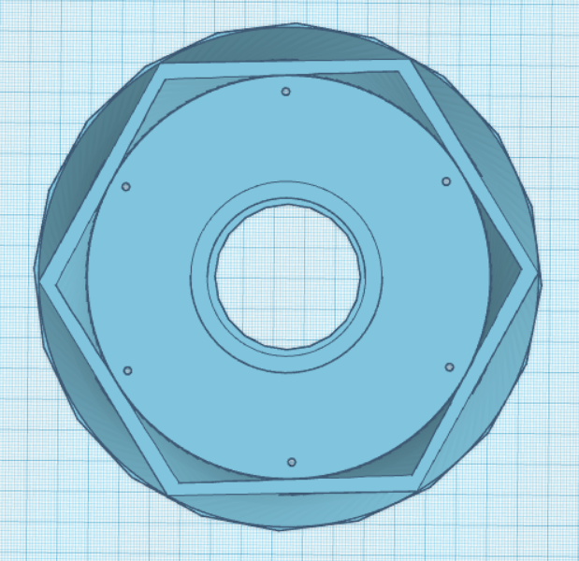
Outer Design

Slide 8

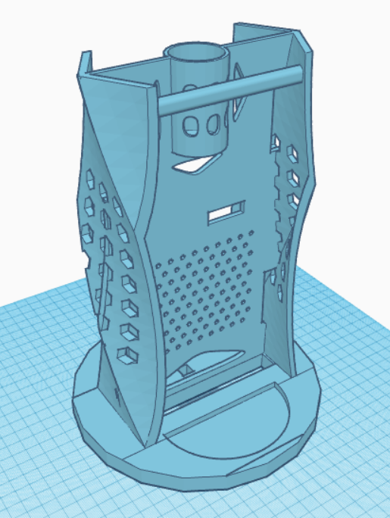
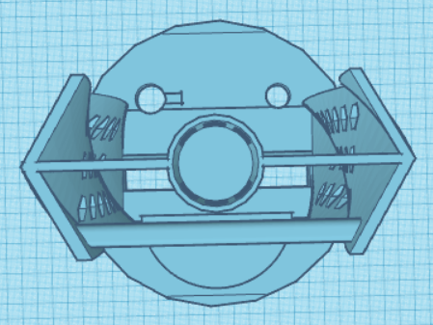
Inner design

Slide 9
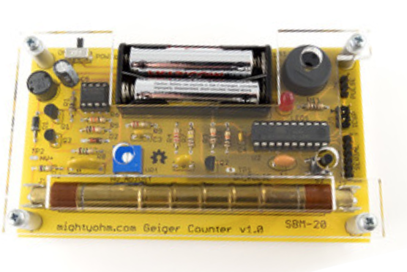
Geiger Counter
Description:
The Geiger Counter measures decaying beta and gamma particles
Goal:
Understand how the radiation increases or decreases while ascending through the atmosphere and compare those data with survivable levels of radiation.

Slide 10
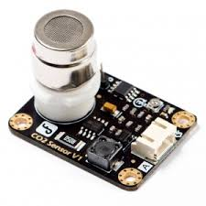
CO2 Sensor
Description:
Measure CO2 concentration in the atmosphere.
Goals:
Determine the change of concentration of CO2 as we ascend through the atmosphere’s layers;
Comparing the concentration of CO2 obtained with theoretical CO2 needed to sustain plant life.

Slide 11
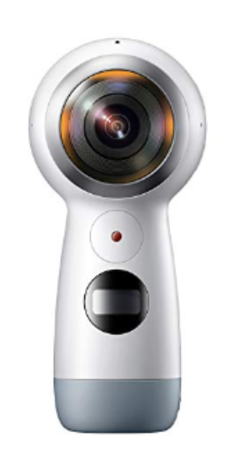
Samsung Gear 360
Samsung SM-R210NZWAXAR Gear 360 (2017 Edition) Real 360° 4K VR Camera

Slide 12
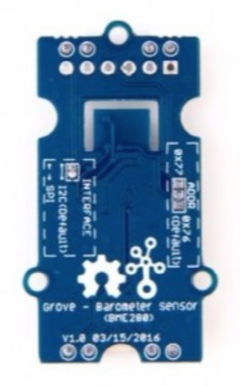
BME280
Description:
The BME280 measures humidity (%), pressure (Pa), altitude (m), and temperature (ºC).
Goal:
Analyzing the change of atmospheric conditions to determine the range to which different type of life forms could prosper in the stratosphere.

Slide 13
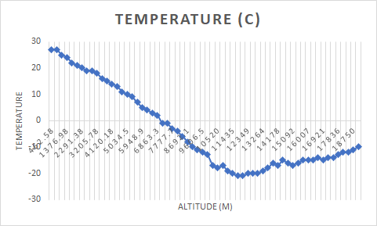
BME DATA

Slide 14
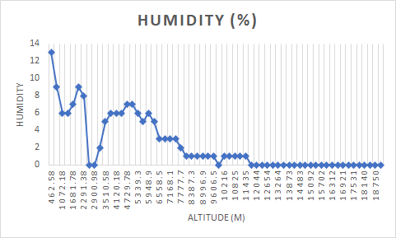
BME DATA

Slide 15
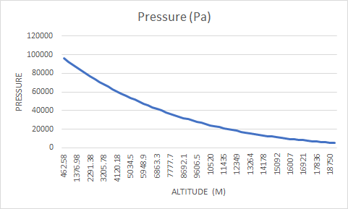
BME DATA

Slide 16
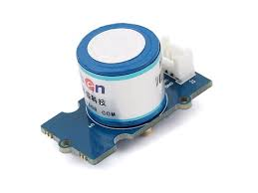
O2 Sensor
Description:
Measure O2 concentration in the atmosphere.
Goals:
Determine the change of concentration of O2 as we ascend through the atmosphere’s layers;
Comparing the concentration of O2 obtained with theoretical O2 needed to sustain micro-organic life.

Slide 17
O2 DATA

Slide 18
Spring 2019: Assessment
What Worked | What Didn’t Work
3D print payload made with PETG worked in 4.46 degrees F | Improperly securing the 360 camera assembly to the payload
Operational arduinos | Data logger for geiger counter was fried, calibration of CO2 sensor failed
Atmospheric data collected | Stopped collecting data around 63,000ft probably due to the lack of insulation

Slide 19
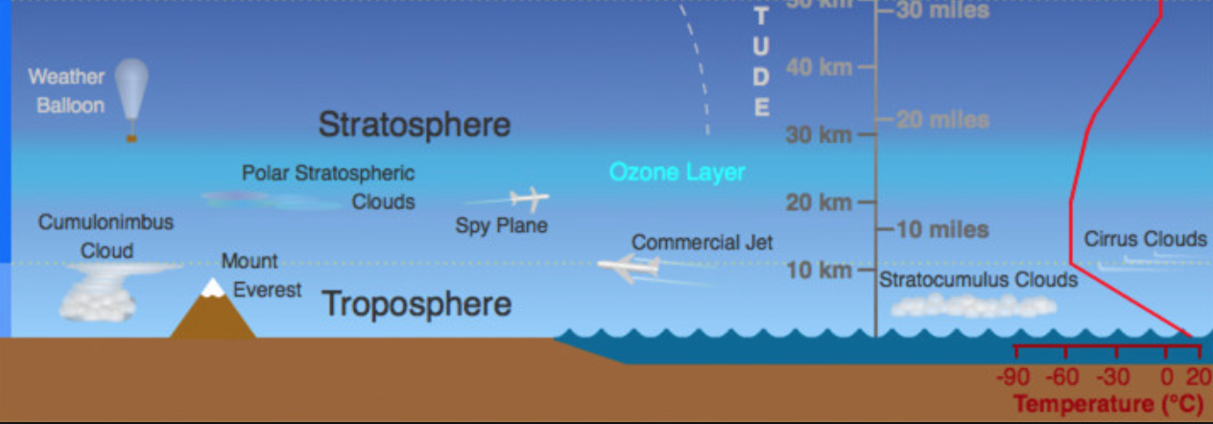
Answer to purpose
Altitude reached

Slide 20
Oxygen and Human Requirements
% Atm Oxygen
23.5% | Maximum permissible oxygen level. | No effect.
21% | Percentage of oxygen found in normal air. | No effect .
19.5% | Minimum permissible oxygen level. | No effect.
15% | Decreased ability to work strenuously. | May impair coordination and may induce early symptoms with individuals that have coronary, pulmonary, or circulatory problems.
12% | Respiration and pulse increase. | Impaired coordination, perception, and judgment occurs.
10% | Respiration further increases in rate and depth. | Poor judgment and bluish lips occur.
8% |  | 8 minutes - 100 percent fatal; 6 minutes - 50 percent fatal; 4-5 minutes - recovery with treatment.
6% |  | Coma in 40 seconds, convulsions, respiration ceases - dea

Slide 21
Pressure and Human Requirements
Lowest atmospheric pressure the human body can withstand is around 6 percent sea level pressure, or 61.8 millibars
Notes:
Disregarding hypoxia, the lowest atmospheric pressure the human body can withstand is around 6 percent sea level pressure, or 61.8 millibars, below that pressure the water and blood in your body starts to boil. This limit, which on Earth occurs at an altitude of roughly 63,000 feet, beyond which humans absolutely cannot survive in an unpressurised environment.

Slide 22




Conclusion
Average atmospheric conditions above 60,000 ft | Requirement for human survival
Oxygen: 15.49% | Oxygen: 15%-19%: negative effects on human body, but not instanteneous death.
Temperature: -10 C, 14F | Temperature: Human survival possible
Pressure: 55 millibars | pressure: 61.8 millibars
Conclusion: | In principle, above 60,000 ft, humans absolutely cannot survive in the unpressurised environment. Moreover, even if not deadly, the lack of oxygen could eventually lead to pulmonary, or circulatory problems.

Slide 23
Ideas for future ASCEND Missions
Collecting more data to answer the same question but for microorganisms
Working on a radio transmission project

Slide 24
Thank you!
ANSR, UofA, NASA, ASCEND,
PIMA CC, and our mentors

